Slide 1
TEAM A - Final Project
Farris M. Hamid, Arnab Shams, Jared, Sudheer Kumar

Slide 2
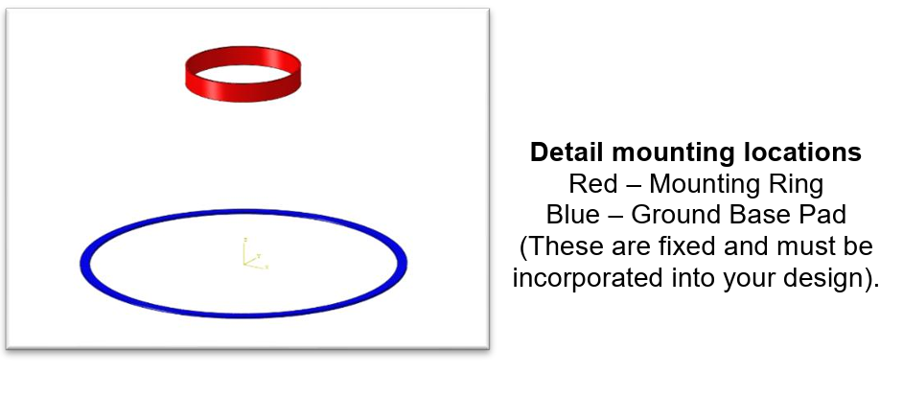
Project Objective

Slide 3
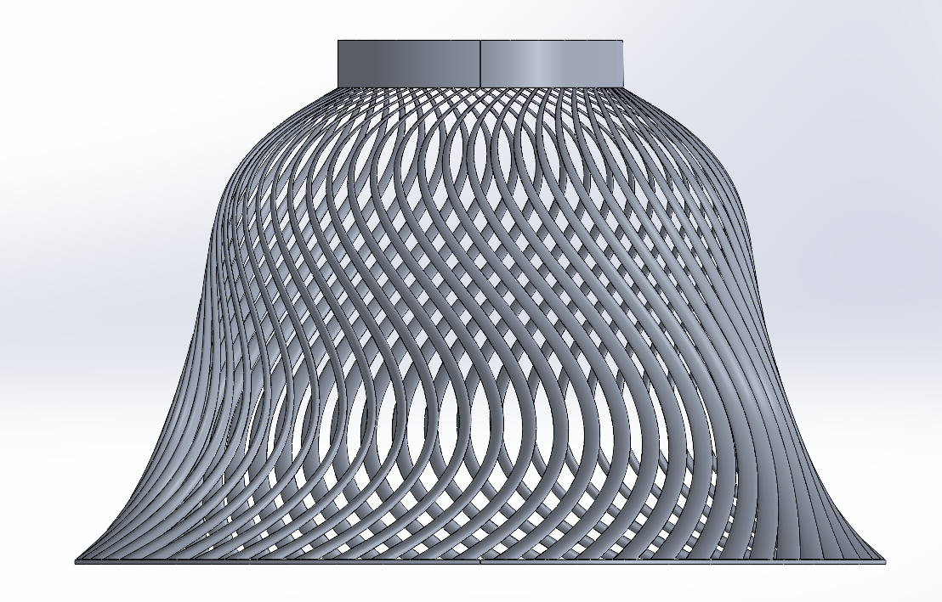
Bell-Shaped Ribbed Conical Shell
Continuous shell geometry
  improves axial load transfer and minimizes stress.
Rings
  top section provides a stable interface for mounting ring and distributes twisting loads.
Taper
  enhance overall stiffness and raise natural frequency.
Uniform wall thickness
  AM feasibility and simplifies modal analysis.
Reduce Mass/Material:
  Internal ribbing or lattice infill to reduce mass while maintaining rigidity.

Slide 4
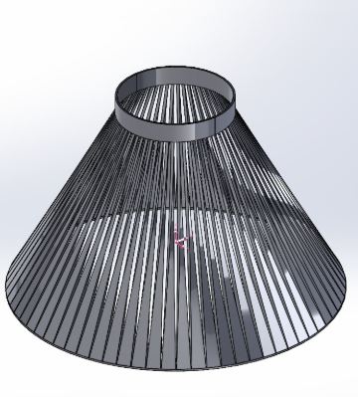
Conical Cage with Ribs
70 evenly spaced vertical rods
  efficiently transfer axial loads from ring to base.
Dual circular rings
  provide lateral and torsional stability under combined loading.
Open-frame design
  minimizes mass and allows easy powder escape in AM processes.
Symmetric:
  Symmetric layout ensures balanced modal response and simplifies FEA boundary conditions.
Make it more Lightweight:
  Could remove some vertical rods to make it Lightweight structure.

Slide 5
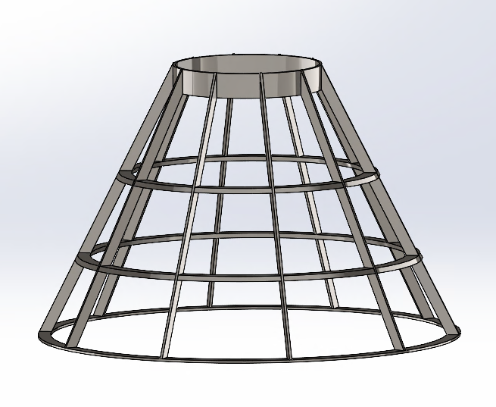

Conical Frames with Ribs
10 angled legs to transfer axial load
2 circular supports for lateral and torsional stability
Made thin to reduce weight while maintaining rigidity
May be able to make lighter with further testing

Slide 6
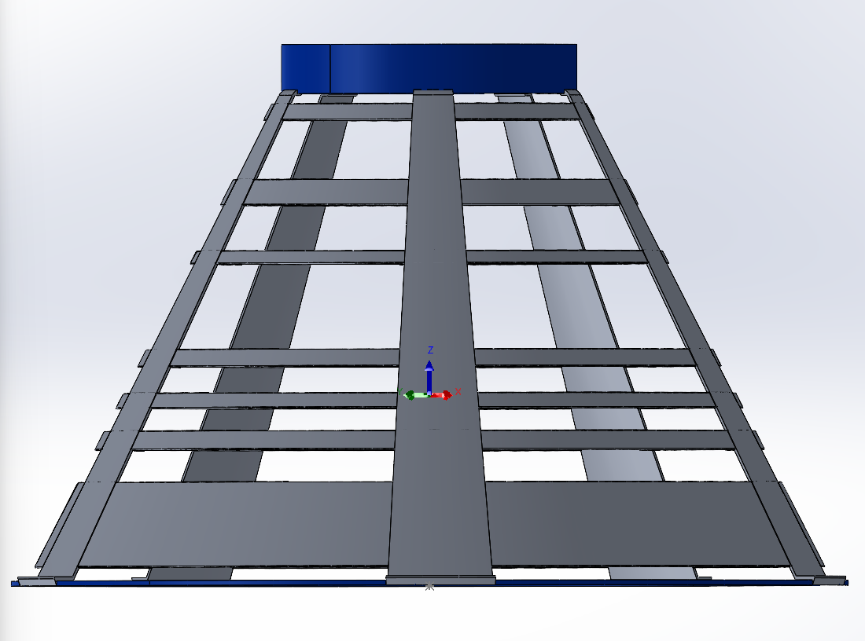
Ribbed Conical Shell
Design: Tapered shell geometry channels axial loads efficiently from ring to base.
Ring: Circular top opening aligns with mounting ring interface; wide base ensures stable ground contact.
AM-friendly design: smooth lofted surfaces, uniform wall thickness, and minimal support material.
Lightweight: Make it lighter with further testing

Slide 7
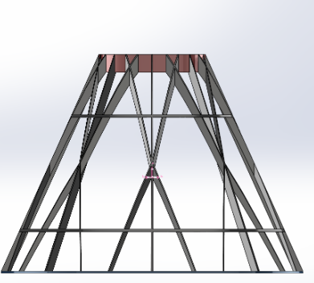

Chosen Concept: Conical Tripod Truss Ribs
Tapered tripod truss geometry
  Axial loads from the mounting ring to the ground base. Sturdy triangular shape takes care of the axial loads.
Symmetry:
  Lateral and torsional stability under combined loading conditions.
AM friendly:
  Self-supporting angles throughout the structure
Lightweight yet rigid:
  Minimal mass while maintaining high stiffness and modal performance.

Slide 8
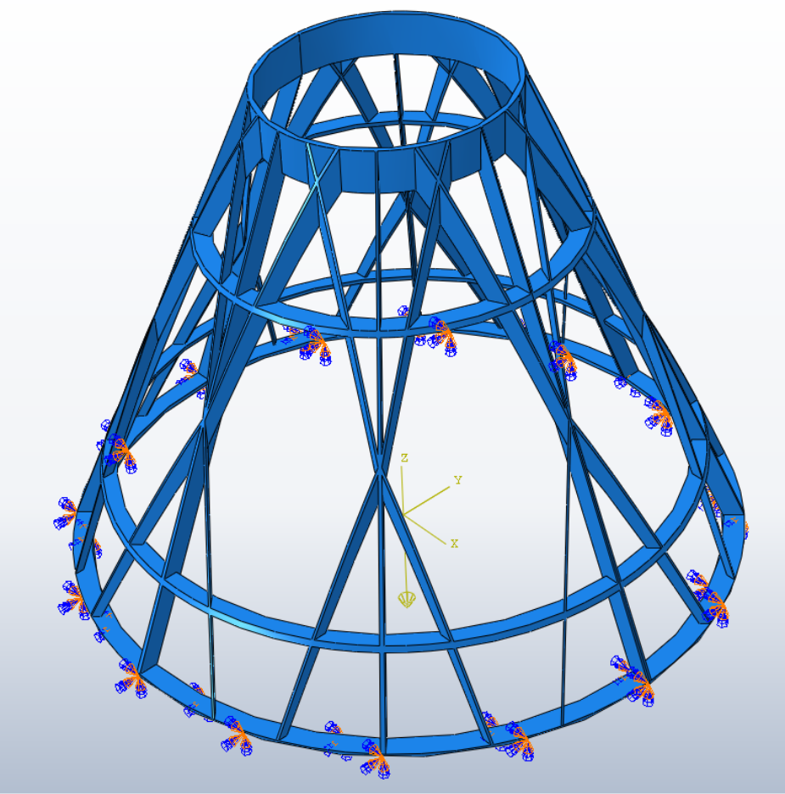
Axial Dead Load (2000N)

Slide 9
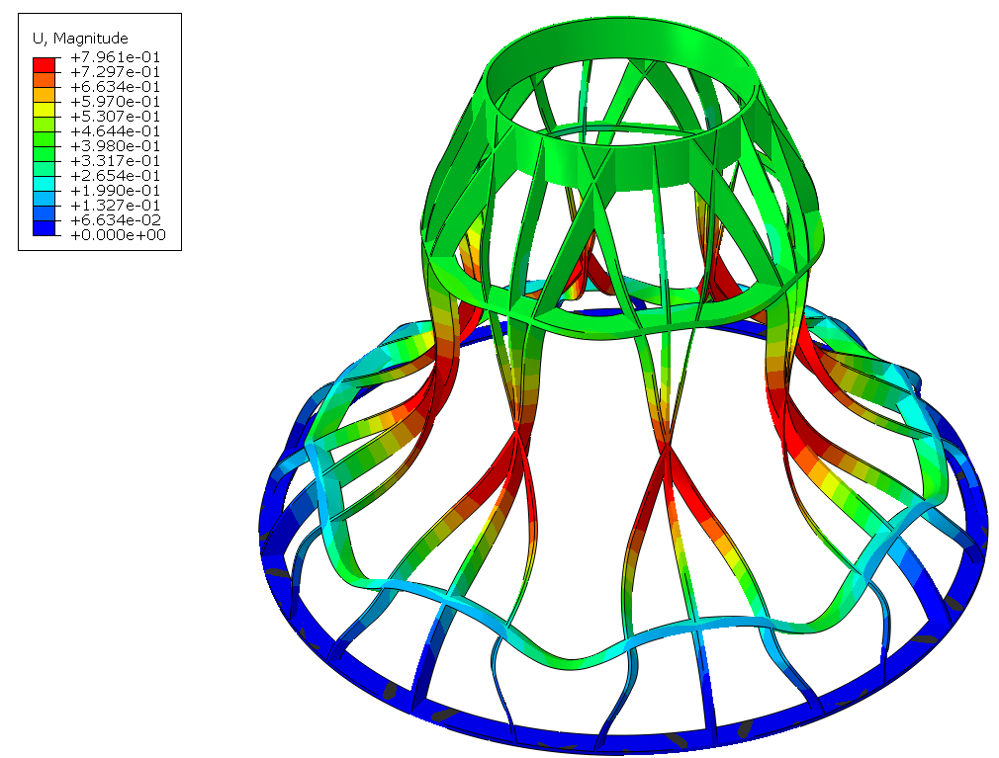
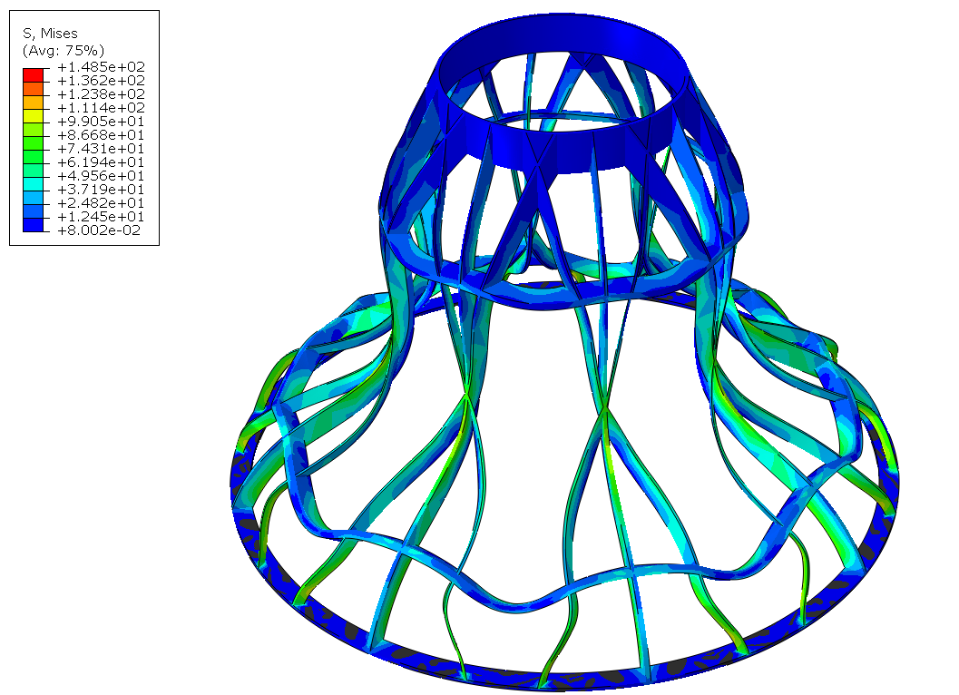
Axial Deadload Results
0.796 mm
148.5 MPa

Slide 10
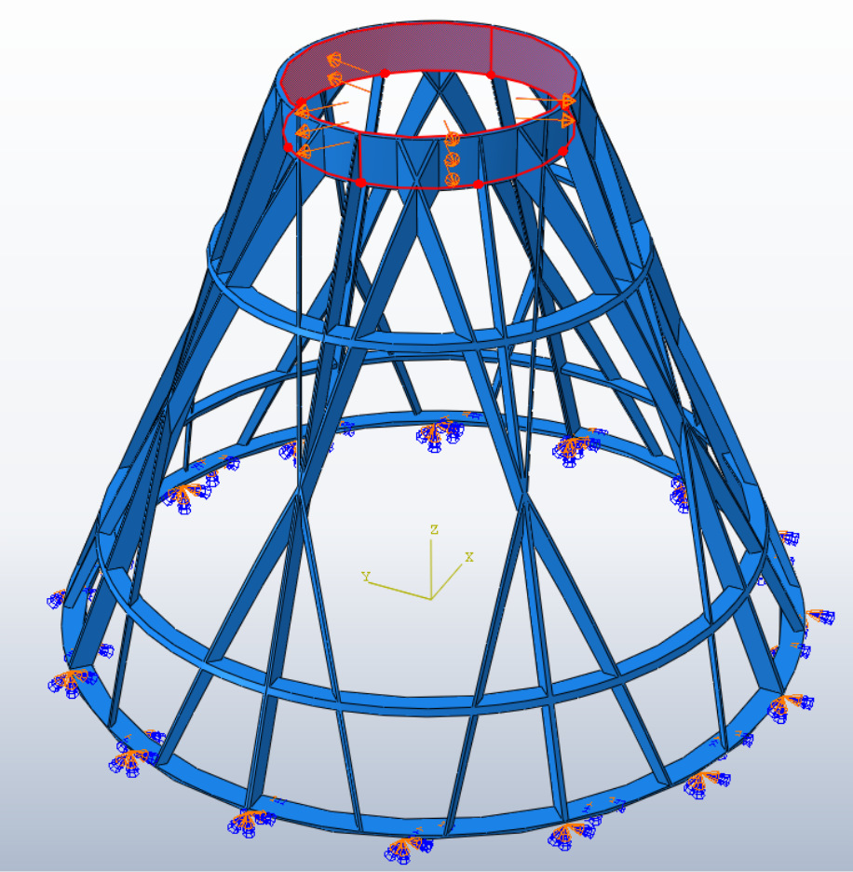
Lateral Load (500N)

Slide 11
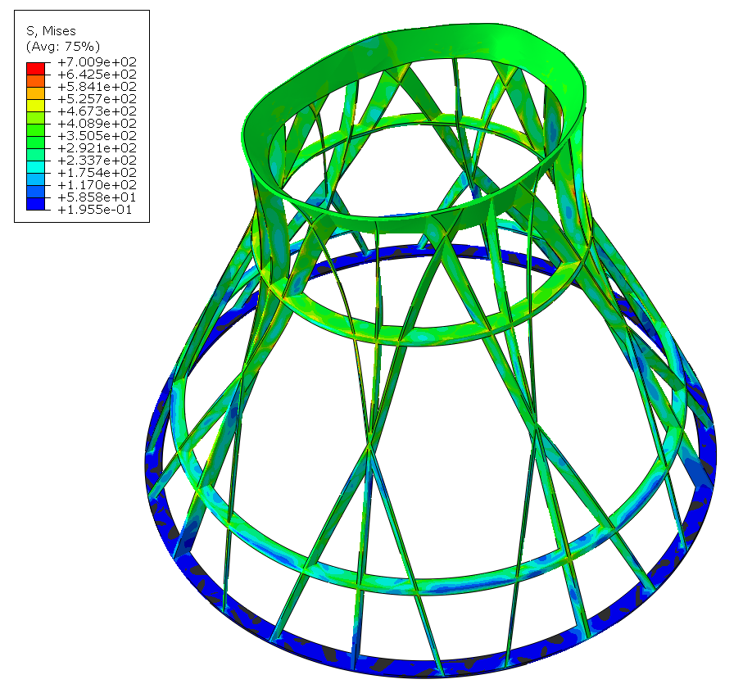
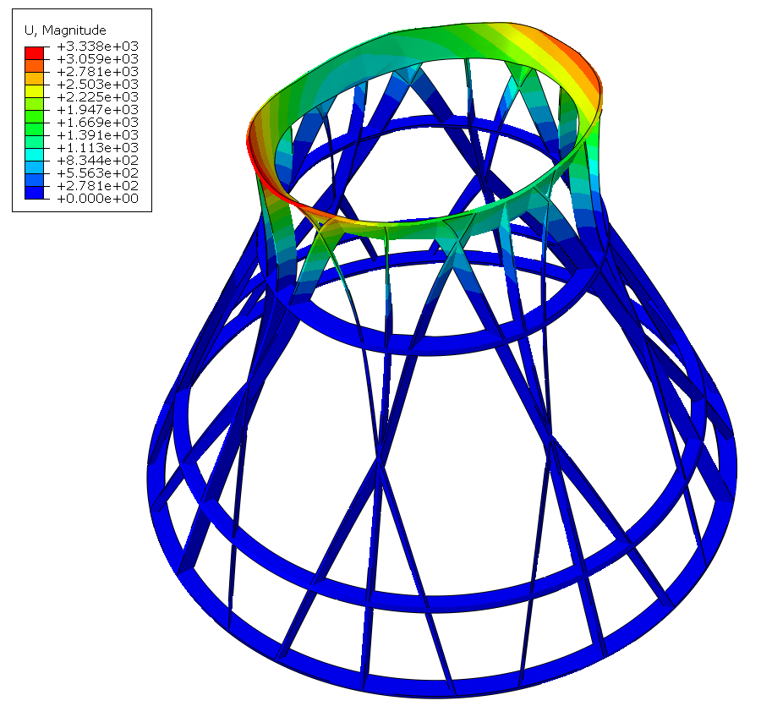
Lateral Load Results
233 – 408 MPa
3.33 mm

Slide 12
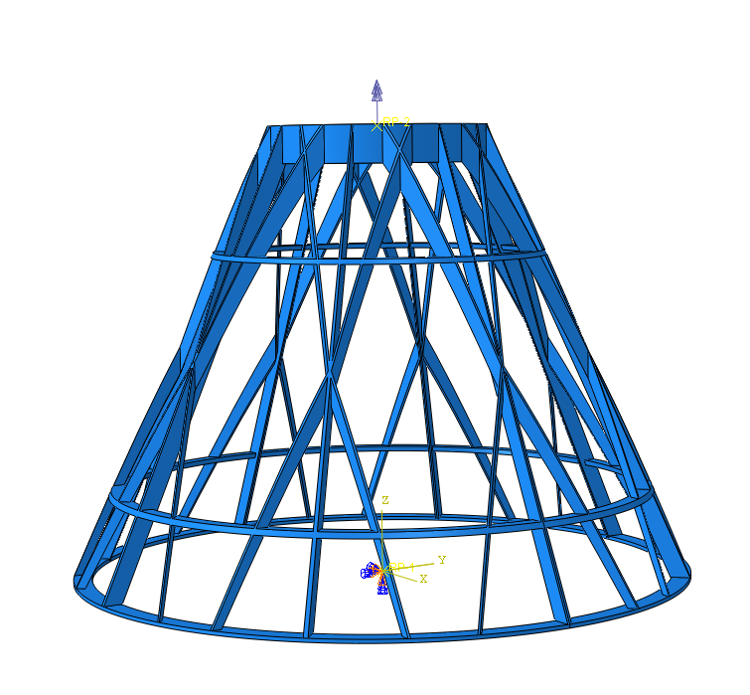
Twisting Load (100N*mm)

Slide 13
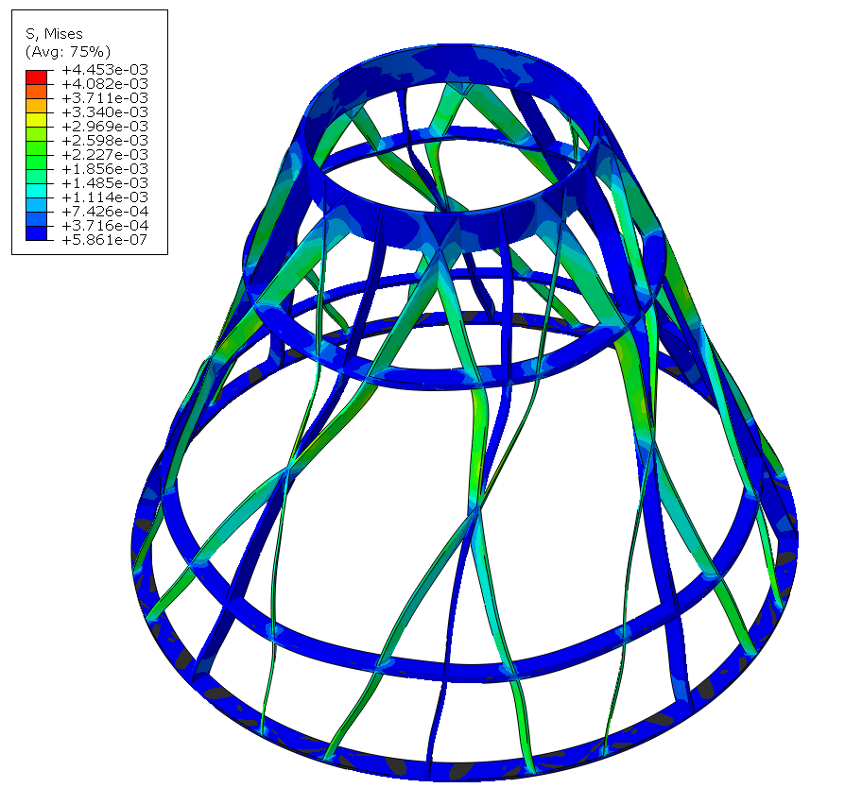
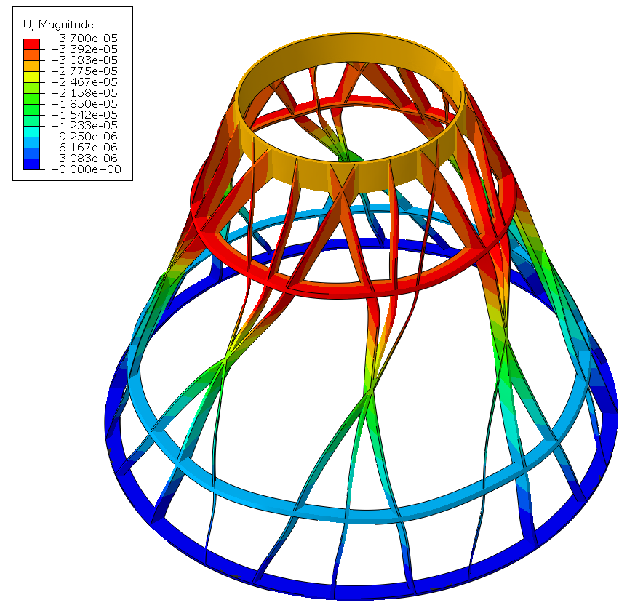
Twisting Load Results (Abaqus)
0.0044 MPa
0.000037 mm

Slide 14
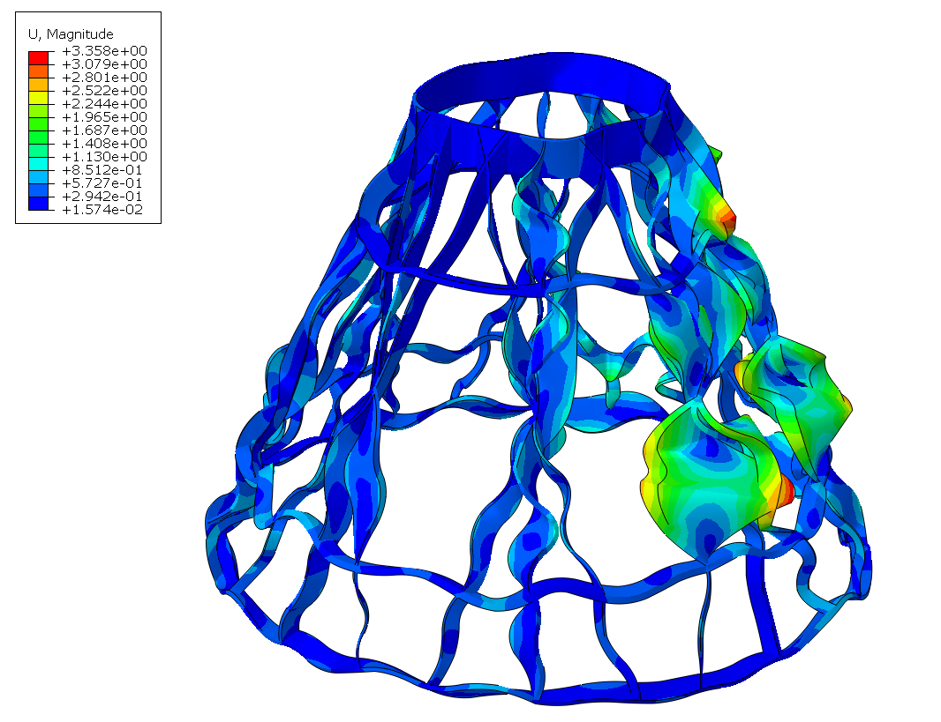

Resonance Load (Abaqus)

Slide 15
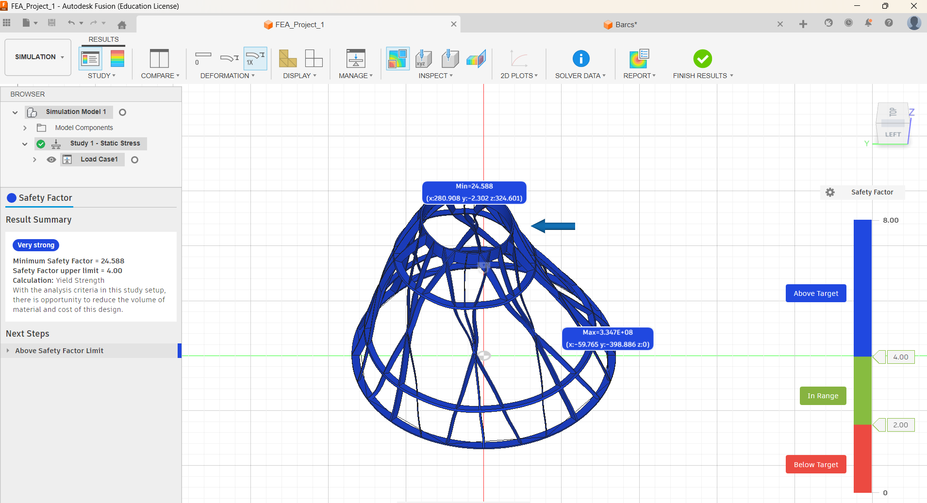
Lateral Load (500N)

Slide 16
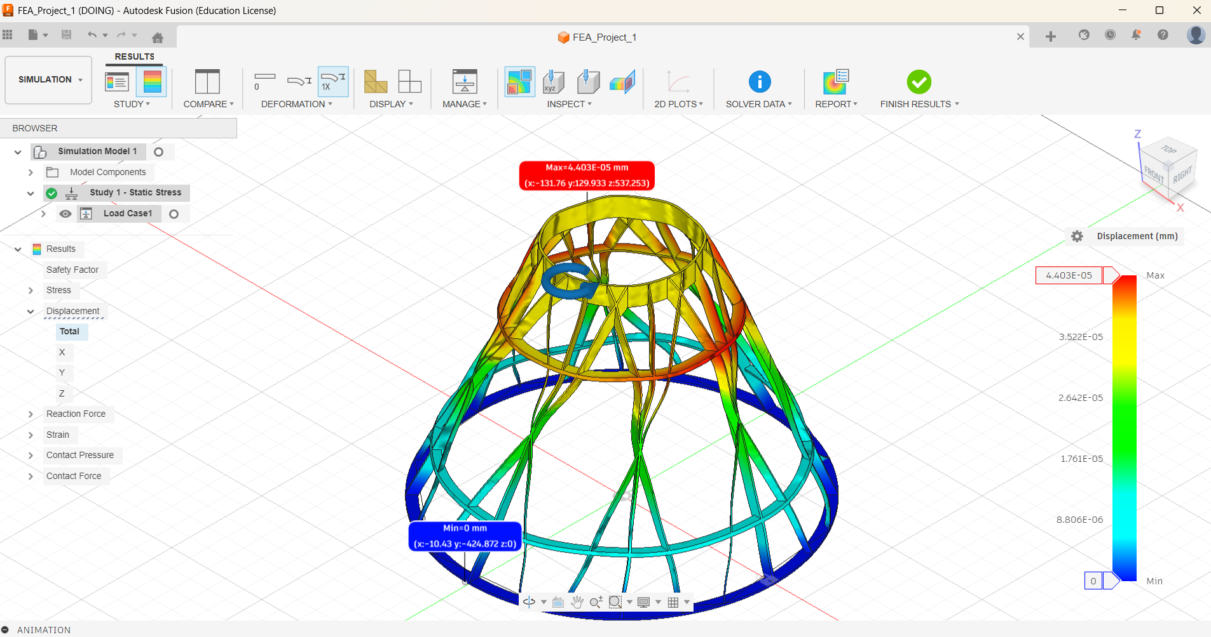
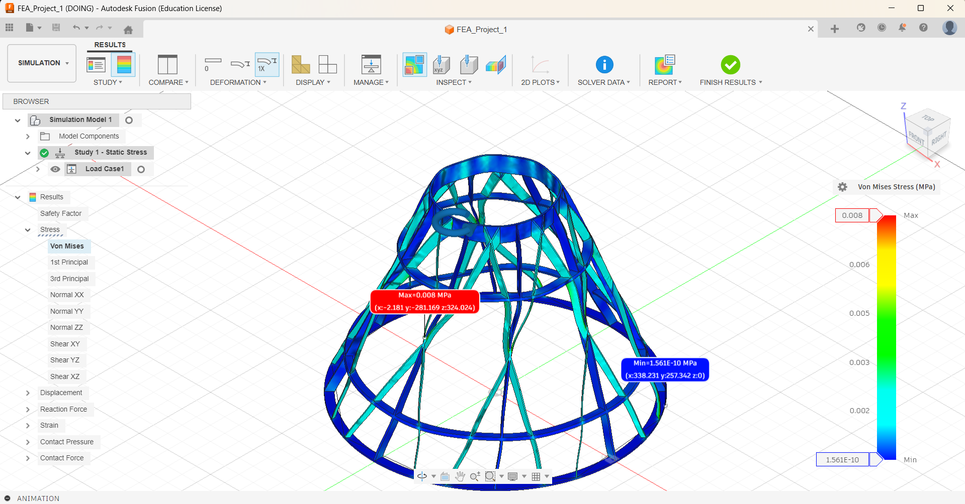
Twisting Load Results (Fusion360)

Slide 17
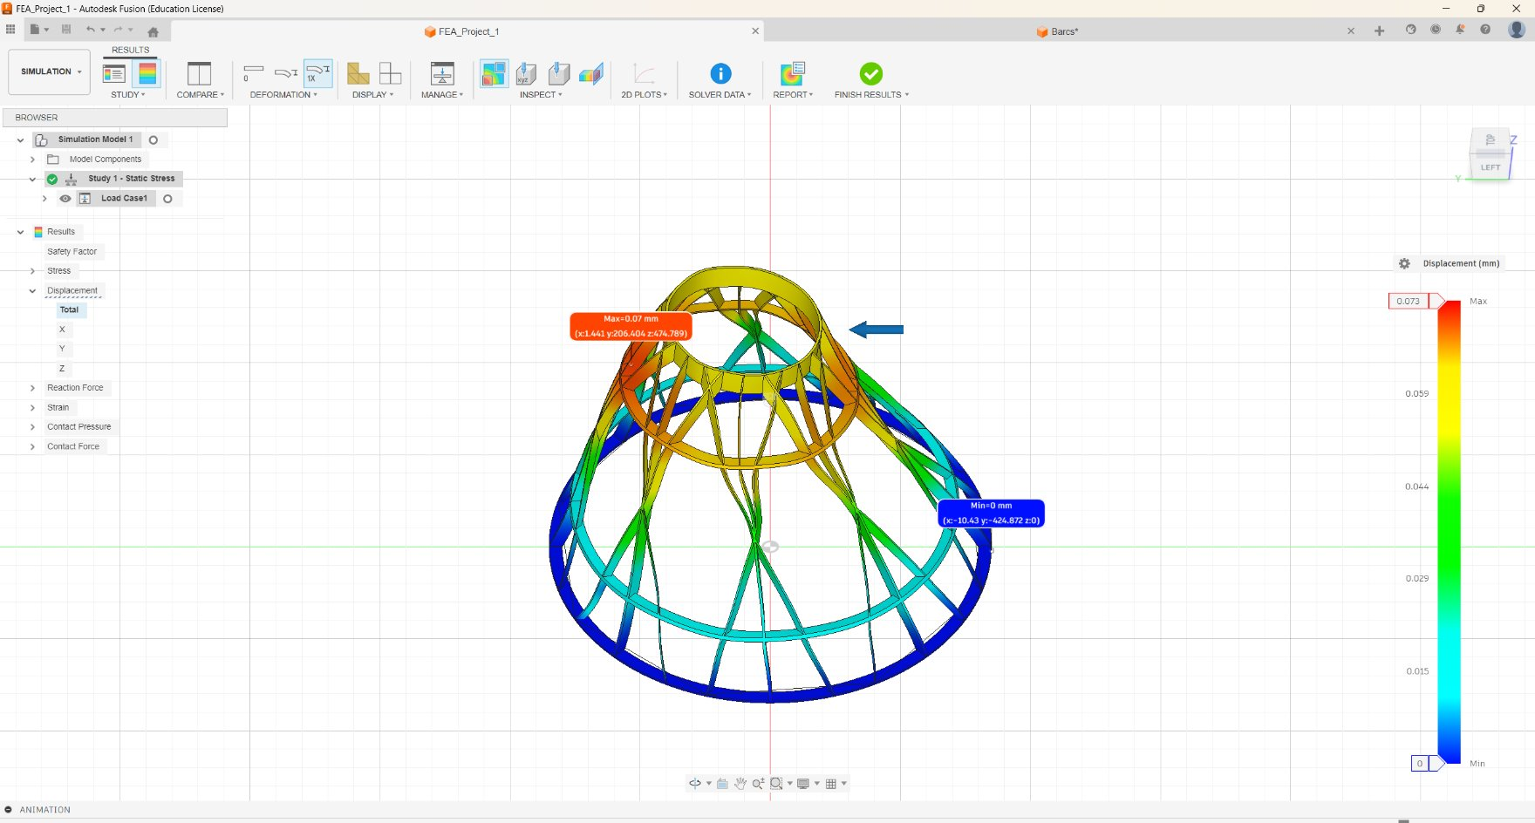
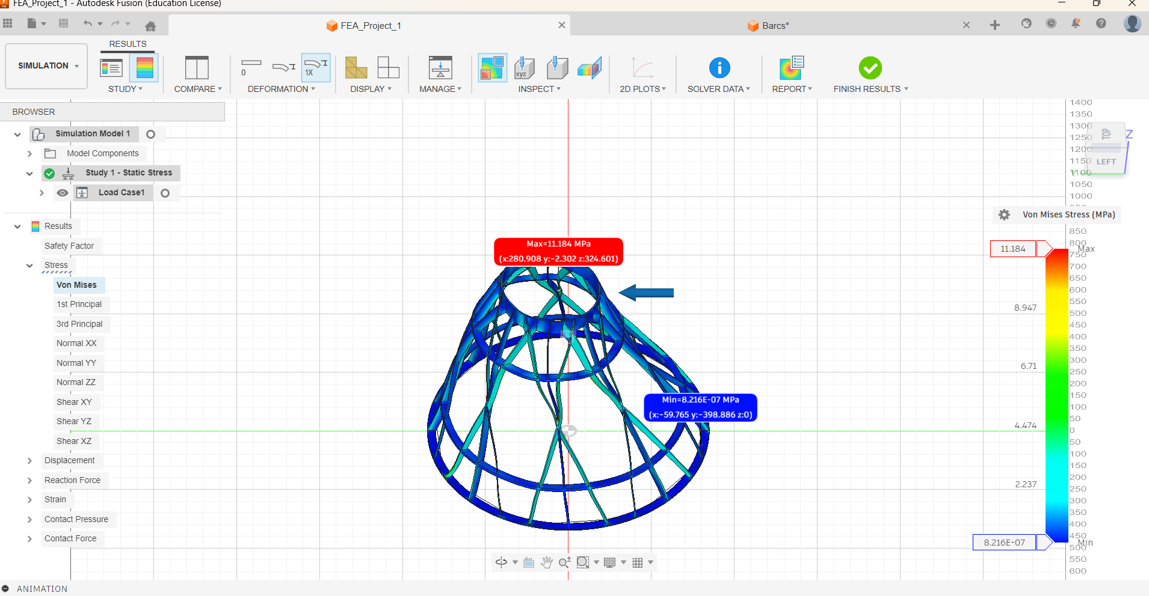

Slide 18
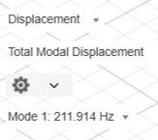
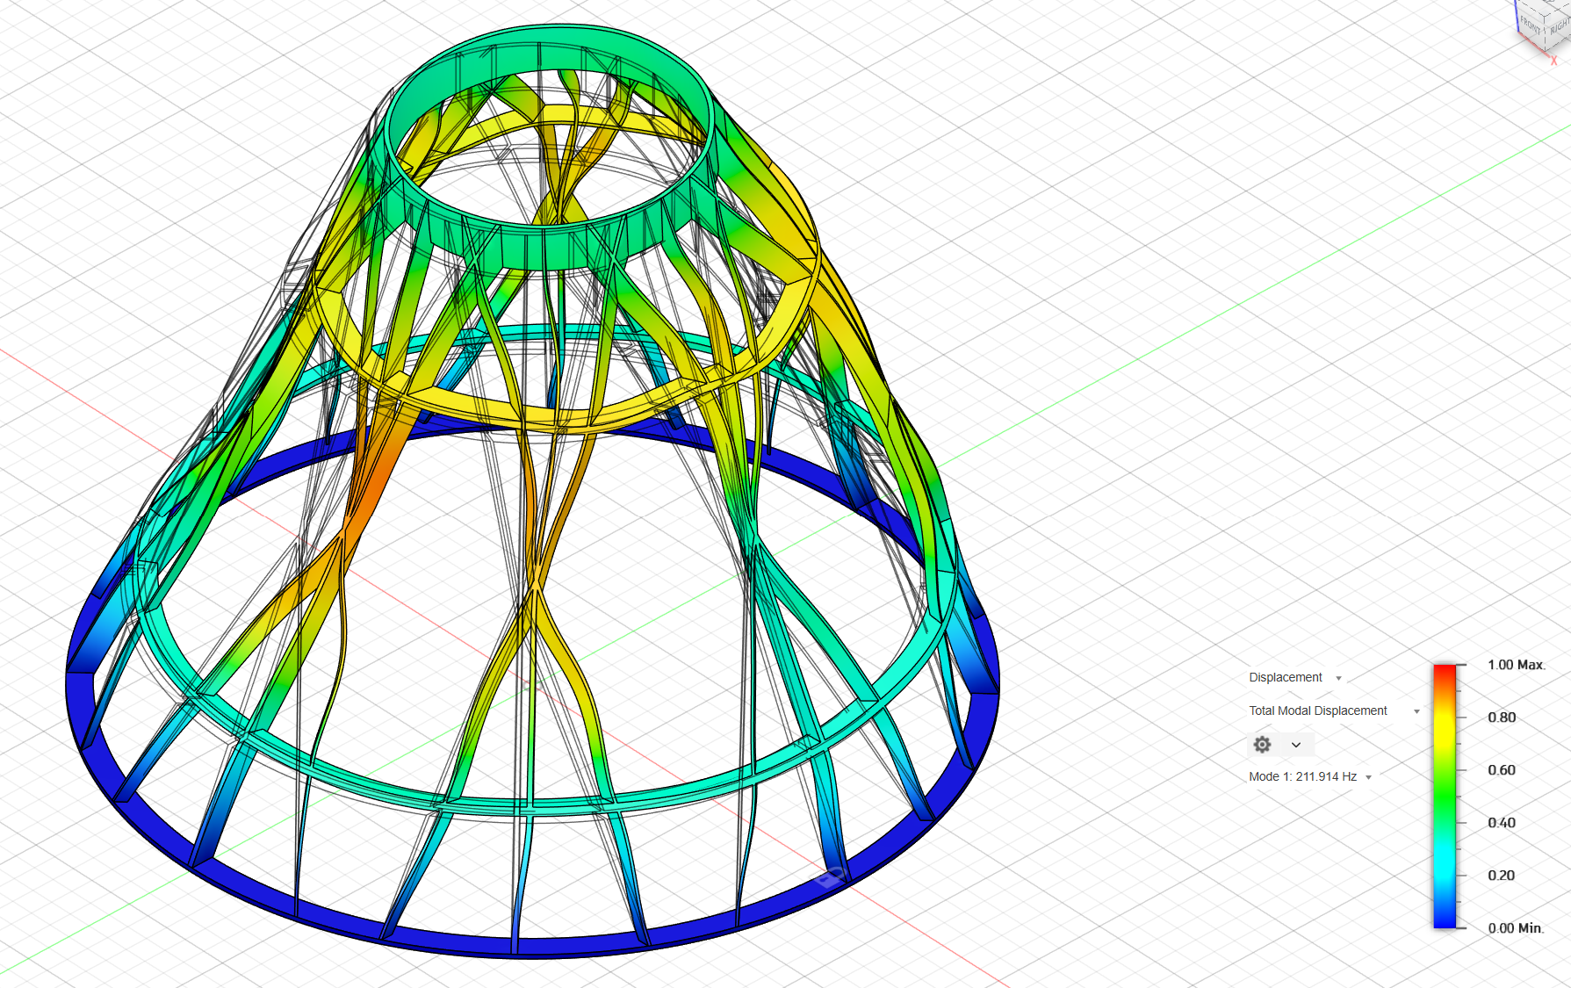
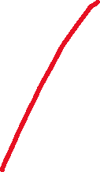

Resonance Load (Fusion360)

Slide 19
Explanation
Factor of Safety for AlSi10Mg (σ = 230-260 MPa)
  F.O.S = Material Strength / Load Applied ~ 1.55-1.75
AM Design
  Powder Bed Fusion AM would work best for this design.
    Allows complex designs with fine features
    Can work with aluminum
Estimated unit cost:
  $350–$600 per stand (including Aluminum material, machine time, post-processing).

